Slide 1
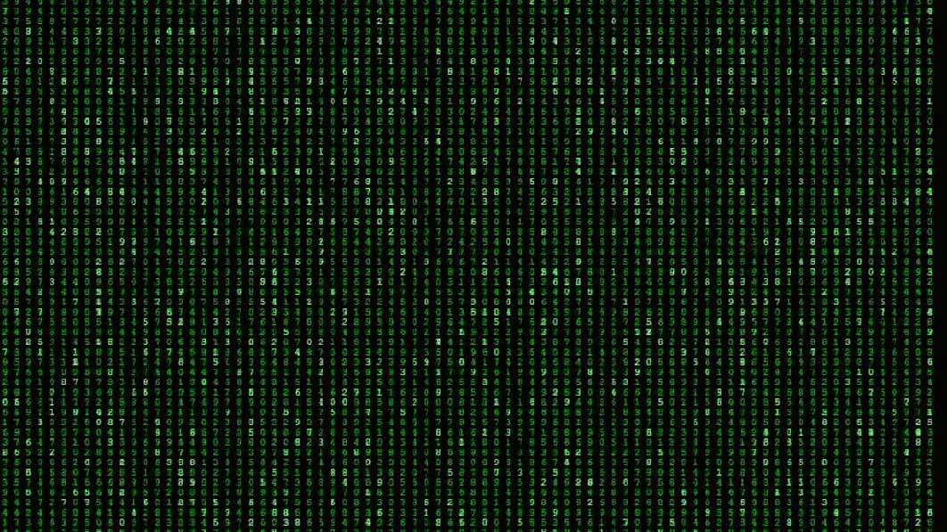
Binary logic and arithmetic
Operating System
Lab№3
Daniil Kuznetsov
Turan Shirinov
Sabina Eskerova

Slide 2

01
Basic information
What we will
learn and discuss today
Operations and order which can be perfomed
02
If you have questions make it comfortable to ask
Features that are common to all digital computers
03

Slide 3
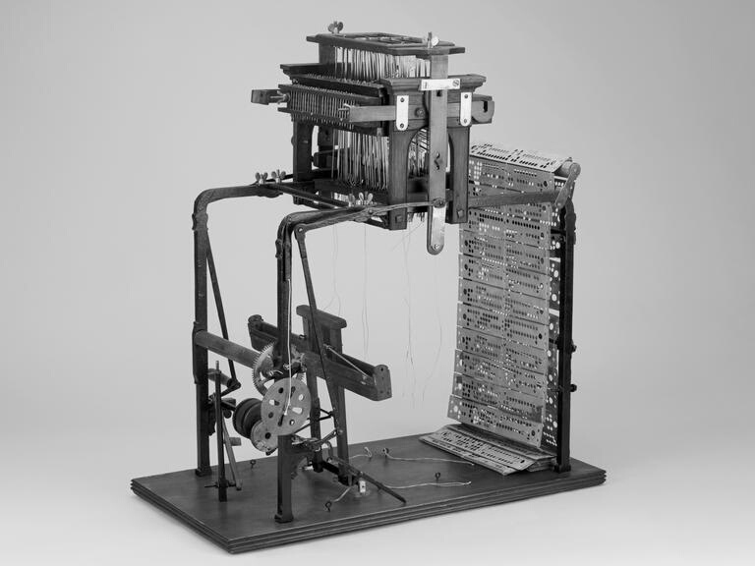
Main info
Computer engineers quickly found that a simpler system less intuitive to humans proved much easier to implement with electronics. This is the binary system, based on only two digits: one and zero. The Jacquard loom was such a binary system, with a hole in a card representing a 1 (one) and the lack of a hole representing 0 (zero). In other applications, turning on a switch might represent a 1, and turning it off might represent a 0. The logic and mathematics of this system were developed mainly by the British mathematician George Boole (1815–64), whose contributions were so important that the concept is often referred to as Boolean algebra.
Jacquard loom
works on Boolean algebra

Slide 4

Types of operations
AND
OR
NOT
AND(sometimes called “intersection” and indicated by the symbol • or ∗) means that, given two statements X and Y, if both are true, then X • Y = 1. If either one is false, then X • Y = 0. For example, the statement “It is raining (X) and the sun is out (Y)” is true only if both it is raining and the sun is out.
OR(sometimes called “union” and indicated by the symbol + ) the inclusive “or” means that, given two statements X and Y, if either one or both are true, then X + Y = 1, while only if both are false is X + Y = 0. For example, the statement “It is raining (X) or the sun is out (Y)” is true in all cases except when both are not true.
NOT (sometimes called “negation” and indicated here by the postsymbol ′ as in X′, but sometimes indicated in other texts with an overbar as in X¯) is an operation performed on a single statement. If X is the variable representing that single statement, then X′ = 0 if X = 1, and X′ = 1 if X = 0.

Slide 5
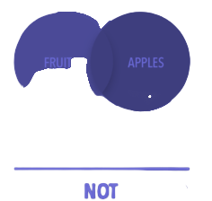
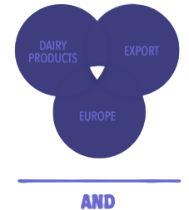
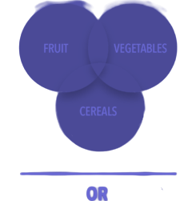
Order and graphical representation
Order is defined as follows:
1
All NOT operators must be evaluated first
all AND operators (starting from the right if there is more than one) second, and
2
all OR operators (starting from the right if there is more than one) are evaluated third.
3

Slide 6
Construction from circuits that have two stable states, forming binary logic elements
Features
Some form of binary storage of data
There are certain features which are common to all digital computers:
Capability to receive and act on data from the outside world (input) and to transmit data to the outside world (output);

